Slide 1
Safety Charter Presentation Electricity

Slide 2
Aim of this presentation: To provide delegates with information and advice to avoid the potential injuries associated with contact with electrical energy that has resulted in fatal accidents within the lift and escalator industry. Disclaimer: This presentation does not constitute formal training in the complete legal requirements for electrical safety or the establishment of safe systems of work when working with electrical energy. It is not intended to address all the legal requirements or associated Approved Codes of Practice, but has been produced to focus attention on the significant risks associated with working in these environments and the significant dangers of electrical energy within the lift and escalator industry.

Slide 3
Accidents: From 1991 to 2011 the UK Lift & Escalator industry experienced 15 fatal accidents. Since the original introduction of the Safety Charter in 2011 the UK Lift & Escalator industry has now experienced another 12 fatal accidents all attributable to the following hazards: - Working at height - Contact with moving equipment/masses - Exposure to electrical energy Contact with electrical energy accounted for 8% of the fatal accidents.

Slide 4
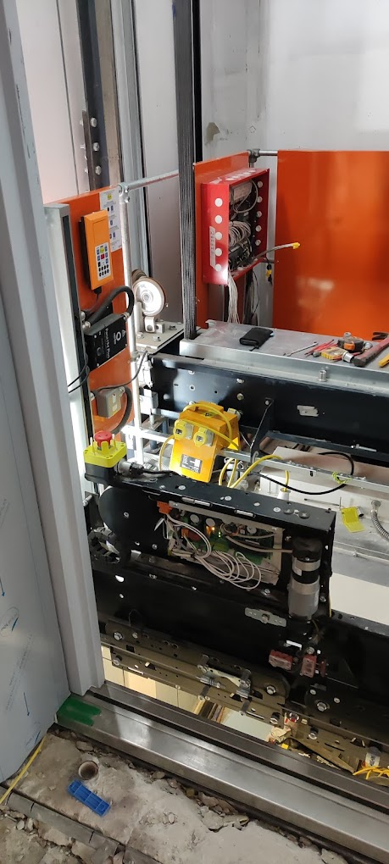
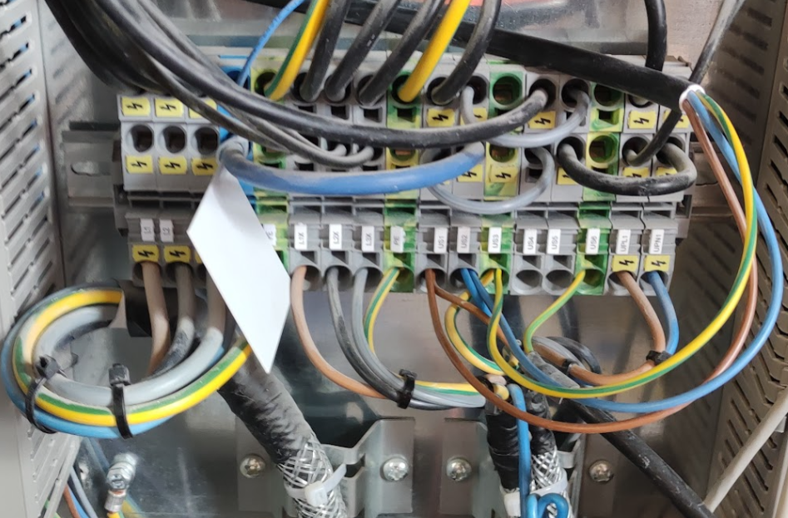
So where could you be exposed to electrical energy in the lift and escalator industry?
Electrical energy is present in many parts of a lift or escalator that may require access during installation, maintenance and repairs and will include electrical energy being present and an electrocution risk from:
Electrical isolators and consumer units.
Lift/escalator controllers
On the lift car top
Under the lift car (1/2 way box)
Lift door gears and electronic interlocks
The car operating panel
Secondary power supplies (multiple lifts)
Lift/escalator lighting circuits
Exposure to earthed metalwork/conductors
Stored energy components
Live working

Slide 5
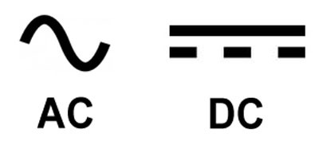
What is the risk associated with exposure to electrical energy?
Electrical injuries caused by a range of voltages – dependant upon circumstances
230V can, and does kill…
Equipment flashovers, burns, loss of muscle control, consequential falls from height can cause fatal injuries.
Electrical shock:
Is the effect of current flowing through the body
Current does the damage and causes:
Muscles to contract
Tissue damage
internal burning
Cardiac arrest
Respiratory failure
The higher the current the more lethal the shock!

Slide 6
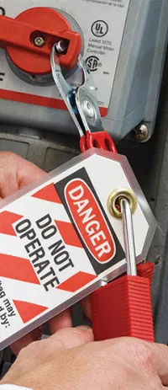
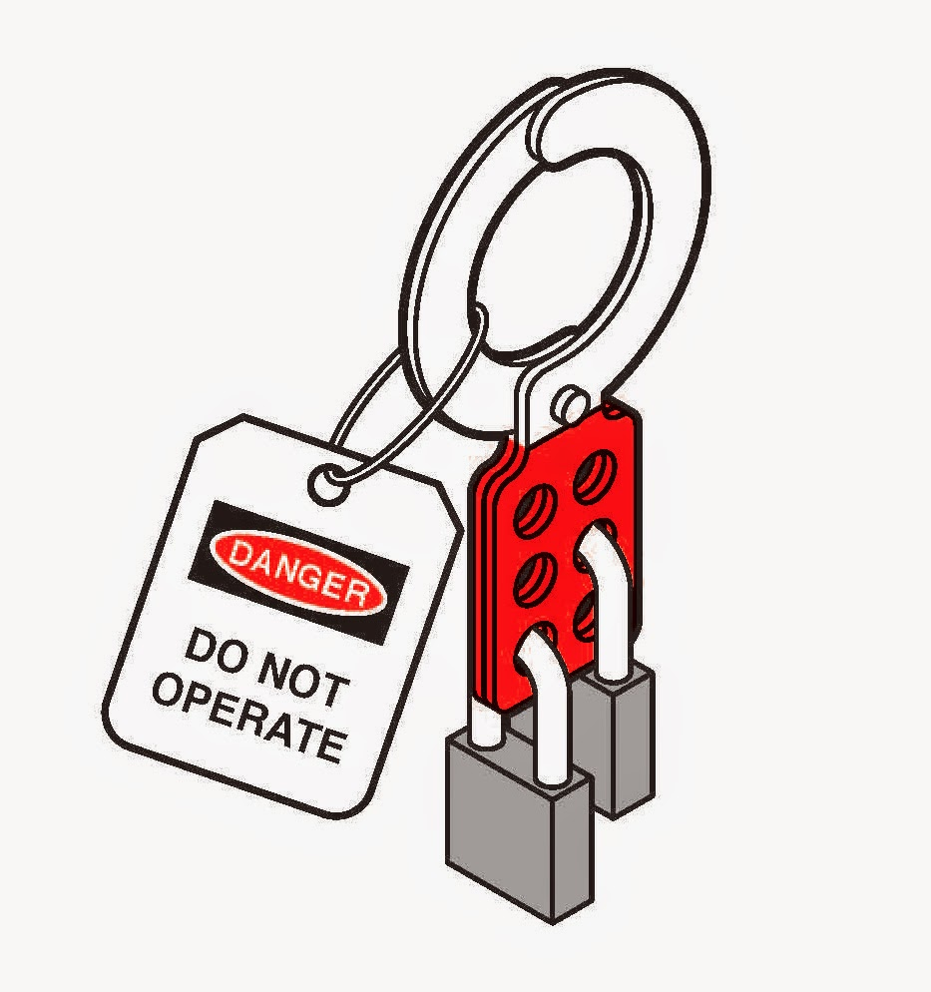
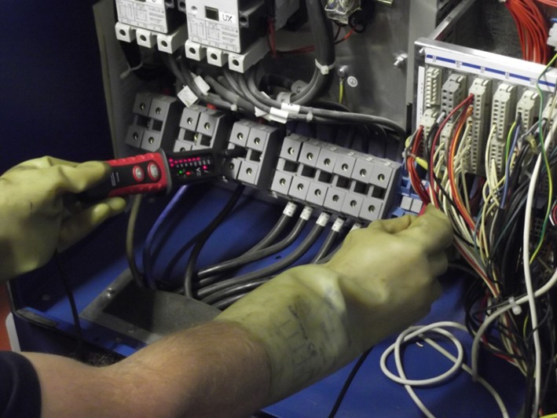
Safe Working with Electricity
Always take precautions when working on or near live electrical equipment.
Always
Lock and tag out the electrical supply when power is not required to perform a task.
If lock and tag out is not possible remove the fuses and keep them with you.
Verify that the disconnection has been achieved by confirming no voltage present.
Allow stored energy components to electrically discharge before working on them.
If more than one engineer each apply their own locks to secure isolation by using a multi-lock hasp lock off device.

Slide 7
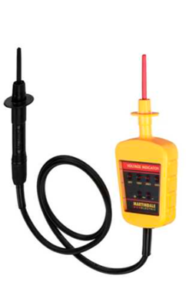
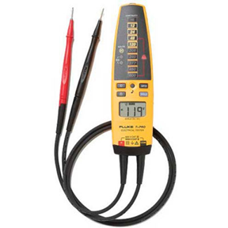
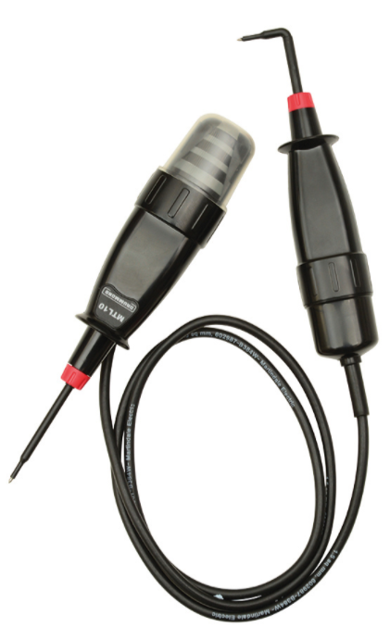
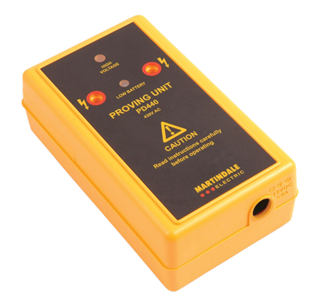
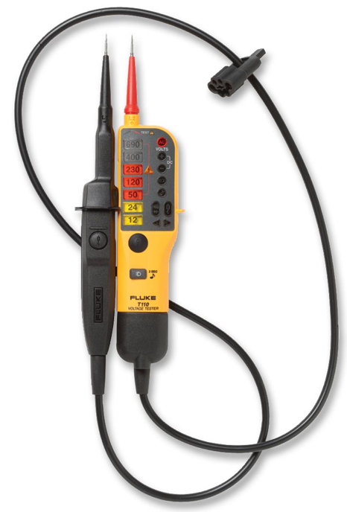
Verifying the circuit is dead
The Electricity at Work Regulations 1989 prohibits work on live conductors where it can be avoided.
The procedure for proving the electrical supply is dead should be by the use of a:
Proprietary test lamp
Two-pole voltage detector
Wear insulating rubber gloves (BSEN 60903) until electrical isolation is proven.
Look away from main electrical isolator to avoid injury from flashover when turning back on.

Slide 8
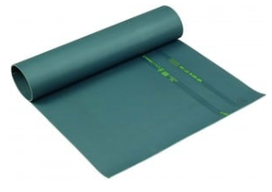
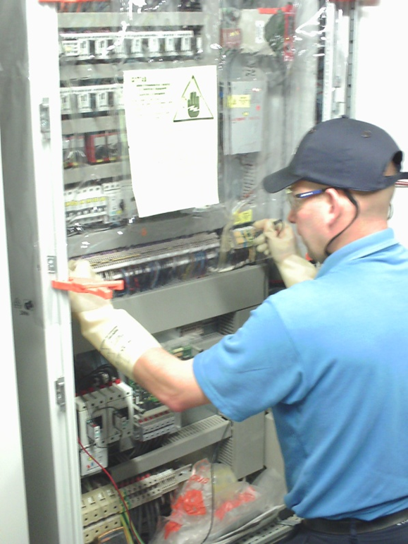
Live Working
Consider whether you have to work live.
If you must work live use suitable PPE, electrical gloves, insulating mats and shrouds.
Wear insulating rubber gloves (BSEN 60903) and test before use.
Use an insulating rubber mat (BS 921)
Fit an insulating shroud to protect against accidental contact with live terminals and wear eye protection to protect against flash over.
Use insulated tools (BS EN 60900) to 1000volts and maintain them in good condition.
Avoid the chance of earthing yourself by removing or covering jewellery.

Slide 9
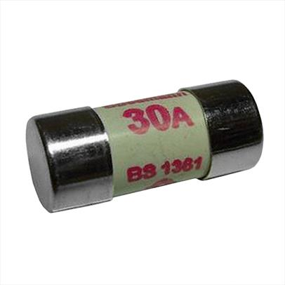
Safe Working with Electricity
Remember
Lock and tag out the electrical supply when power is not required to perform a task.
If lock and tag out is not possible remove the fuses and keep them with you.
Verify that the disconnection has been achieved by confirming no voltage present.
Allow stored energy components to electrically discharge before working on them.
If you have to work live take precautions by:
wearing electrical insulating gloves
standing on insulated mats
using shrouds to cover exposed electrical conductors
using insulated tooling

Slide 10
Review of the aim of this presentation: To provide delegates with information and advice to avoid the potential injuries associated with contact with electricity that has resulted in fatal accidents within the lift and escalator industry. Please take this information seriously and apply the required control measures to protect you so you can go home safely every day to your loved ones. Thank you! Further information on working safely within the industry can be found in the Lift & Escalator Site Safety Handbook 2019

