Slide 1
Safety Charter Presentation Moving Equipment/Masses

Slide 2
Aim of this presentation: To provide delegates with information and advice to avoid the potential injuries associated with contact with moving equipment and moving masses that has resulted in fatal accidents within the lift and escalator industry. Disclaimer: This presentation does not constitute formal training in the complete legal requirements for machinery guarding or the establishment of safe systems of work when working in close proximity to moving equipment or moving masses. It is not intended to address all the legal requirements or associated Approved Codes of Practice, but has been produced to focus attention on the significant risks associated with working in these environments and the significant dangers of moving equipment and moving masses within the lift and escalator industry.

Slide 3
Accidents: From 1991 to 2011 the UK Lift & Escalator industry experienced 15 fatal accidents. Since the original introduction of the Safety Charter in 2011 the UK Lift & Escalator industry has now experienced another 12 fatal accidents all attributable to the following hazards: - Working at height - Contact with moving equipment/masses - Exposure to electrical energy Contact with moving equipment/masses accounted for 67% of the fatal accidents.

Slide 4
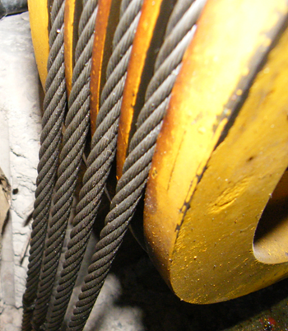
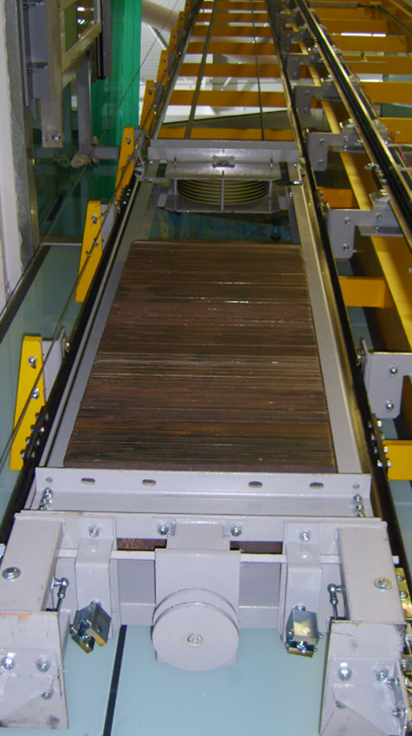
So what is moving equipment or moving masses in the lift and escalator industry?
Rotating equipment (sheaves) in machine rooms and hoistway (nips and pinch points).
Travelling on the car top with potential crush points in the hoistway.
Falling from the car top and being crushed between the car and hoistway.
Working from the lift landing on the car top with the potential of being pinned if the lift car moved.
Working in the pit with the potential of being struck or crushed by the lift car or counterweight.
Working in the lift pit of a common lift hoistway with no division screens with the potential of being struck by an operating lift.
Working within the step band/pit of an escalators/moving walks with the potential of being dragged into the step band mechanism.

Slide 5
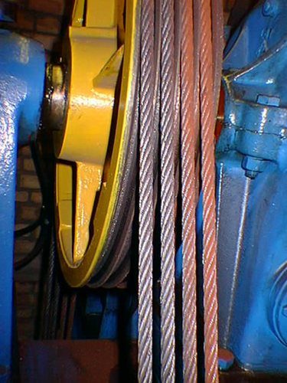
Moving Equipment and Moving Masses and the risk of being Struck/Crushed
In the machine room:
Unguarded rotating sheaves are the biggest risk of serious injury in machine rooms from nips and pinch points resulting in serious hand injury
Control Measures:
Ensure that the machine sheaves and governor are guarded, If not…
Isolate the equipment by activating the “stop switch” if working in close proximity and electrically isolate using LOTO.

Slide 6
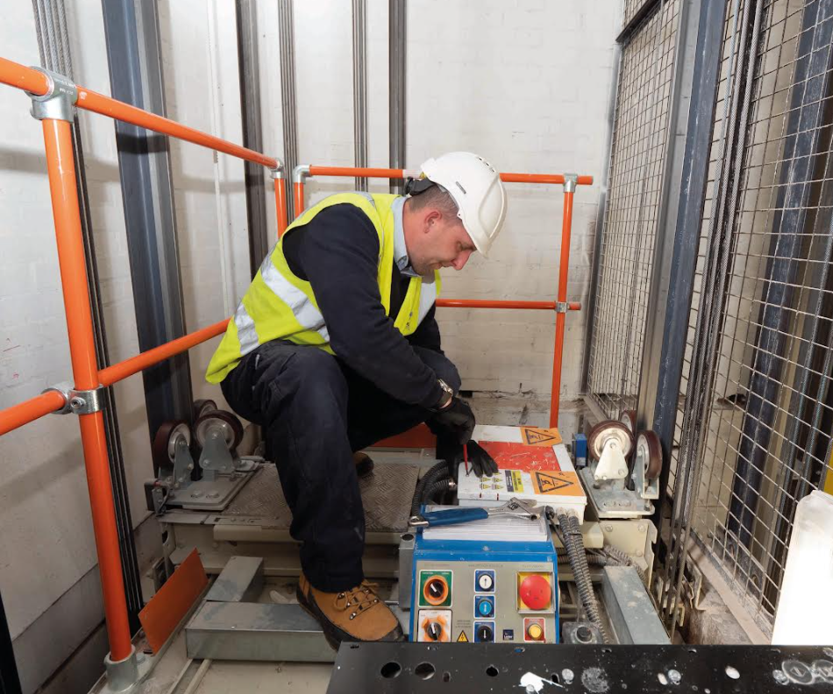
Moving Equipment and Moving Masses and the risk of being Struck/Crushed
On the Car Top being:
Crushed between the car top and landing door header
Crushed due to restricted head room in the hoistway
Struck by fixed objects in the hoistway
Struck by the counterweight at the ½ way point in the hoistway
Trapped between the car and the hoistway wall
Control Measures:
Verify the safety circuit prior to accessing the car top
Check for restricted head rooms prior to accessing the car top
Keep within the “safe zone” of the car top
Keep away from the car top edges
Use fall restraint equipment to prevent falls from the car top

Slide 7
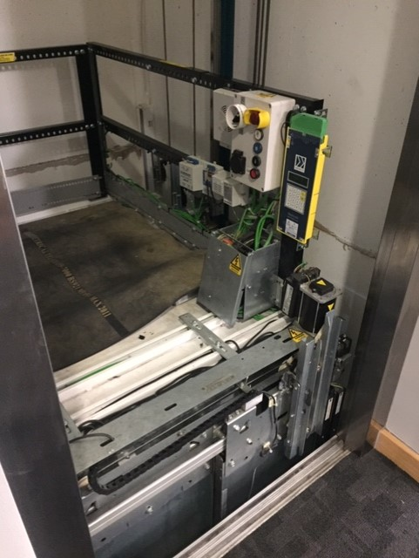
Moving Equipment and Moving Masses and the risk of being Struck/Crushed
Working from the lift landing being:
Crushed between the car top and landing door header
Control Measures:
Verify the safety circuit prior to accessing the car top
If required isolate the electrical supply to the lift
Verify the holding brake is functional

Slide 8
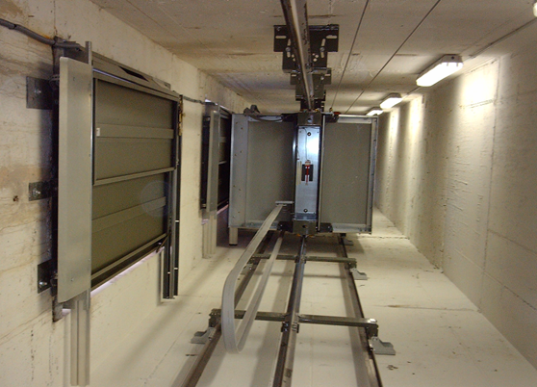
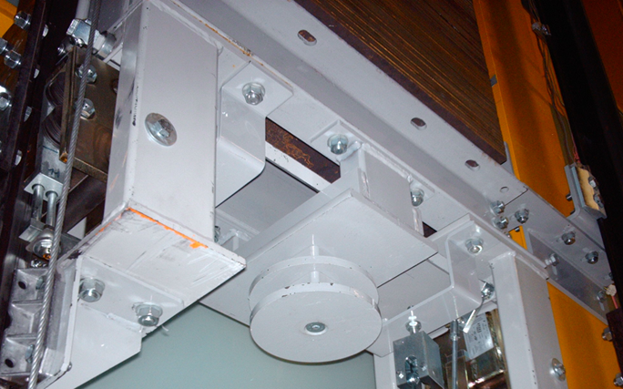
Moving Equipment and Moving Masses and the risk of being Struck/Crushed
Working in the pit and being:
Struck or crushed by the car descending
Struck or crushed by the counterweight
Control Measures:
Verify the safety circuit prior to accessing the lift pit
Ensure there is adequate guarding of the counterweight
Ensure that division screens are in place
Isolate and LOTO all lifts if the above is not in place

Slide 9
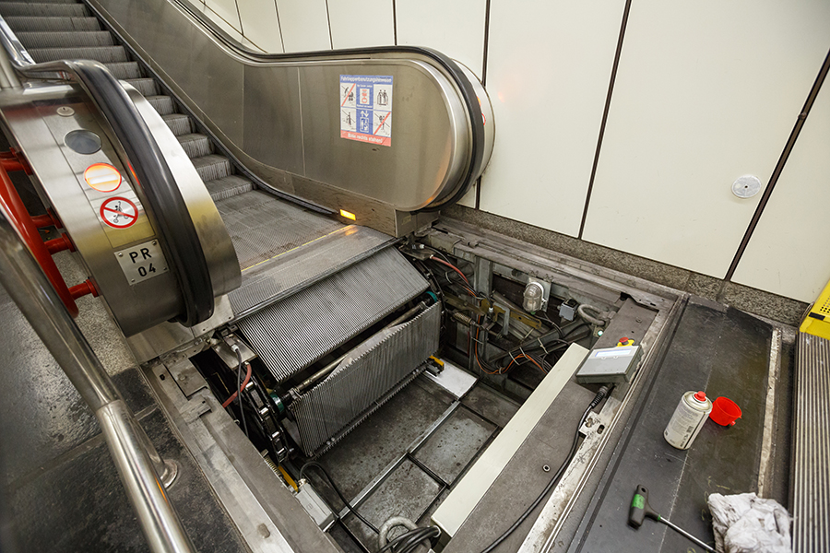
Moving Equipment and Moving Masses and the risk of being Struck/Crushed
Working within the step band truss/pit of an escalators/moving walks and being:
Dragged into the step band mechanism.
Control Measures:
Isolate the power supply before working in the pit.
Isolate the power supply and secure the step band before removing steps and accessing the truss.
Lubricate the step chain from outside the pit using a lubrication device.

Slide 10
Review of the aim of this presentation: To provide delegates with information and advice to avoid the potential injuries associated with contact with moving equipment and moving masses that has resulted in fatal accidents within the lift and escalator industry. Please take this information seriously and apply the required control measures to protect you so you can go home safely every day to your loved ones. Thank you! Further information on working safely within the industry can be found in the Lift & Escalator Site Safety Handbook 2019

