Slide 1
Safety Charter Presentation Working at height

Slide 2
Aim of this presentation: To provide delegates with information and advice to avoid the potential injuries associated with working at height that has resulted in fatal accidents within the lift and escalator industry. Disclaimer: This presentation does not constitute formal training in the complete legal requirements for working at height or the establishment of safe systems of work. It is not intended to address all the legal requirements or associated Approved Codes of Practice, but has been produced to focus attention on the significant risks associated with working in these environments and the significant dangers associated with working at height within the lift and escalator industry.

Slide 3
Accidents: From 1991 to 2011 the UK Lift & Escalator industry experienced 15 fatal accidents. Since the original introduction of the Safety Charter in 2011 the UK Lift & Escalator industry has now experienced another 12 fatal accidents all attributable to the following hazards: - Working at height - Contact with moving equipment/masses - Exposure to electrical energy Falls from height accounted for 25% of the fatal accidents.

Slide 4
So where can you fall from?
From the landing
From the car top
Through trapdoors
From ladders and stepladders
From scaffolds or working platforms
From any unprotected edges

Slide 5
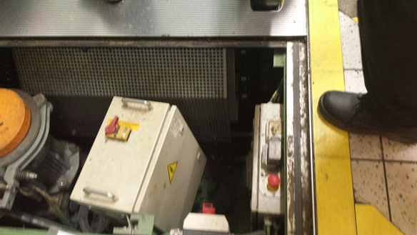
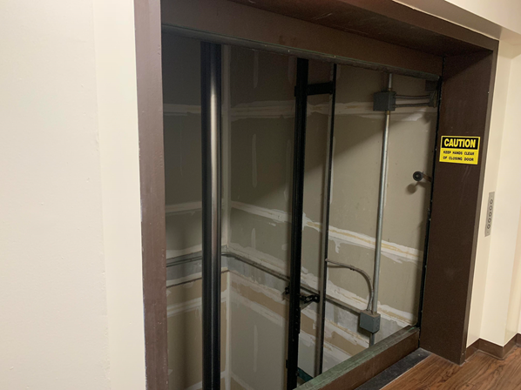
Risk of Falling
From the lift landing:
Down the well into a pit or onto the car top
From the lowest landing into the pit
Control Measures:
First open door minimal amount to establish car position/depth of pit
Make sure lighting adequate
Protect open landing doors or when doors removed with barrier – type determined by the work being undertaken
Positioning the car such that a fall is not possible – for example when working on doors
Suitable pit ladders and careful transition from landing to ladder and visa versa when entering or leaving the pit

Slide 6
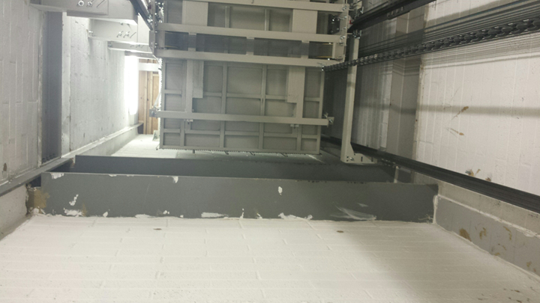
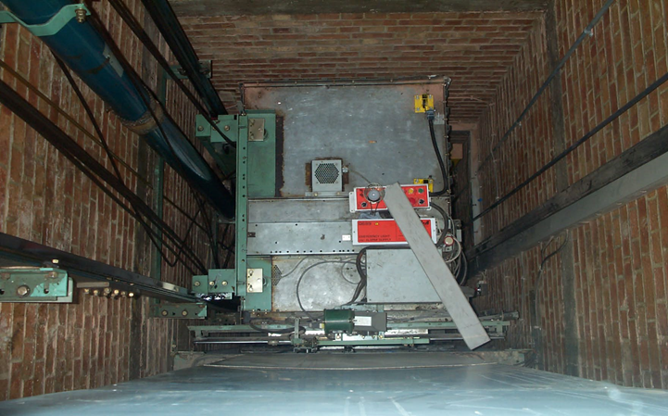
Risk of Falling
From car top:
Down the side/back where there are unprotected voids (anything greater than 300x300mm is a hazard.
Into adjacent shafts where there is no dividing screen or protection on the car top.
Observation lifts.
Control Measures:
Fixed barriers fitted in position on car top.
Other engineering measures – full height screens and horizontal extensions to car top.
Personal fall restraint equipment*
*Note the use of any type personal equipment must be risk assessed and genuinely be the last resort not a quick and easy option.

Slide 7
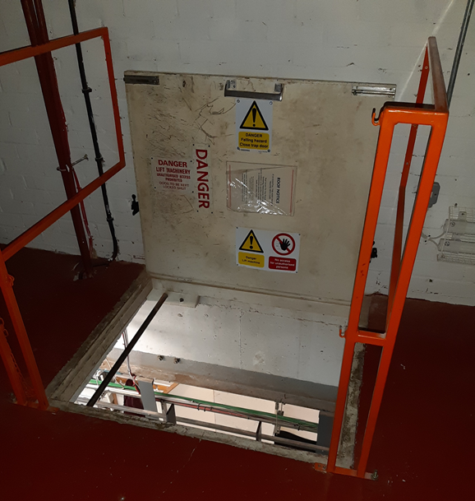
Risk of Falling
Through opening or fragile materials:
Trapdoors
Control Measures:
Reclose whenever possible.
Don’t step or stand on unless unavoidable.
Ensure integrity – as far as you can.
When open to lift equipment up or down there must be something to prevent you falling through.
Retain safety barriers provided around the trapdoor wherever possible.

Slide 8
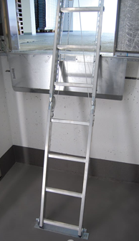
Risk of Falling
Access equipment:
Pit ladders
Access ladders to machine rooms/machine spaces
Control Measures:
Ladders are to be of sound construction and capable of taking your weight
Used for access or light work of short duration (less than 30 mins)
Rungs clean, and soles of boots not wet or oily
Tools will not fall from pockets
Maintaining 3 points of contact at all times
Pre use checks
- Check ladder not damaged
- Check you will not overload the ladder
- It is on a firm level base
- For a leaning ladder it is at correct angle (4:1)
- Securely fixed at top, bottom or middle and footed while this is being done.

Slide 9
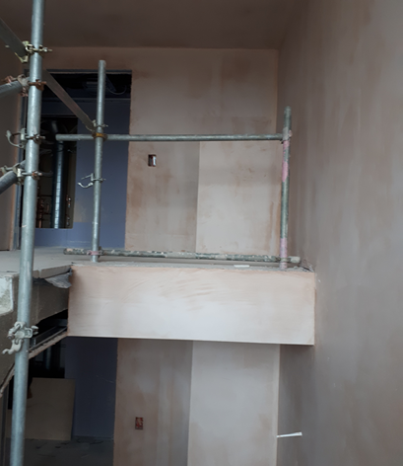
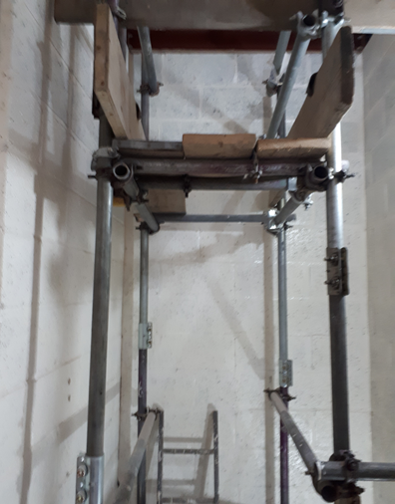
Risk of Falling
From scaffolds and working platforms:
Scaffolds and working platforms within the lift well
General access scaffolds
Control Measures:
Scaffolds erected and inspected by competent person and records kept.
Only altered by competent person.
Inspected every 7 days.
Fully boarded with guard rails and toe boards provided.
Not overloaded with equipment.
Safe access via for example a tied ladder.
Keep working and intermediate platforms fully boarded.

Slide 10
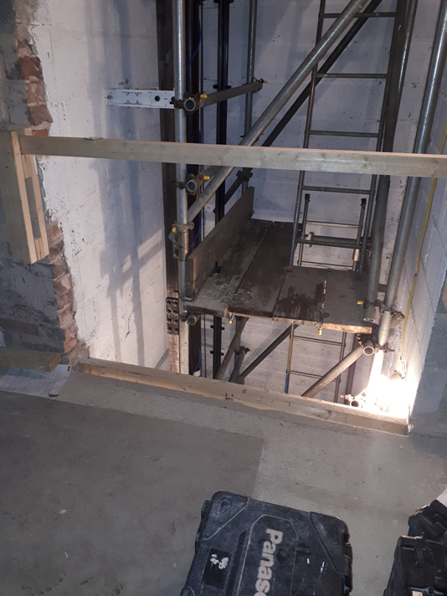
Risk of Falling
From unprotected edges and fragile materials:
Roofs
Stairwells
Risers
Roof lights
Control Measures:
Flat roofs should be provided with railings or some fixed means of preventing falls from the edge.
Keep as far away from the edge as possible.
Avoid any skylights.
Observe any warning signs (e.g. warning fragile roof).
Keep to any identified walking route.
Don’t attempt access in poor lighting and bad weather.

Slide 11
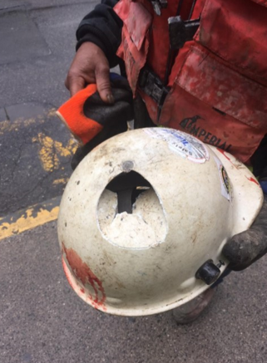
Risk of Falling Objects
Materials/equipment/tooling falling from height:
Possible anywhere on a construction site
One person working directly above another
Other contractors working above
Persons in machine room above while working in shaft
Control Measures:
Safety helmets must be worn in construction environment in workplace and moving around the site
Avoid one person working above another – if essential risk assess the situation and establish a safe system which protects the person below
If work underway in machine room above and in shaft simultaneously consider temporarily blocking rope holes and similar

Slide 12
Review of the aim of this presentation: To provide delegates with information and advice to avoid the potential injuries associated with working at height that has resulted in fatal accidents within the lift and escalator industry. Please take this information seriously and apply the required control measures to protect you so you can go home safely every day to your loved ones. Thank you! Further information on working safely within the industry can be found in the Lift & Escalator Site Safety Handbook 2019

